Slide 1

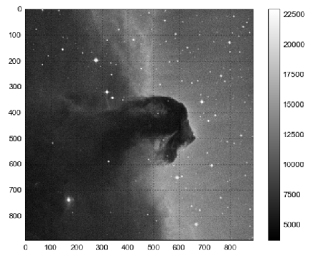


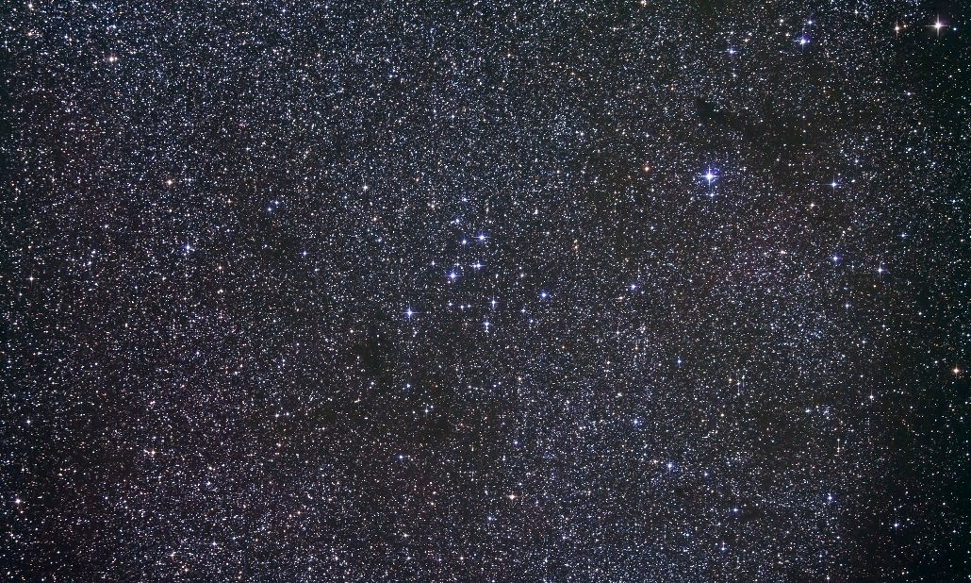
!!! TITLE
!!! SUBTITLE
PREPARED BY
MATT HOLMAN
PAUL BLANKLEY
RYAN JANSSEN
STRICTLY PRIVATE AND CONFIDENTIAL
30 NOVEMBER 2017

Slide 2

MILLIONS OF MISSING ASTEROIDS!
CONNECTING PARTIAL ASTEROID TRACKLETS
Mandate from Congress:
>90% of potentially hazardous asteroids must be tracks
Currently, we have 170m observations of known asteroids

Slide 3
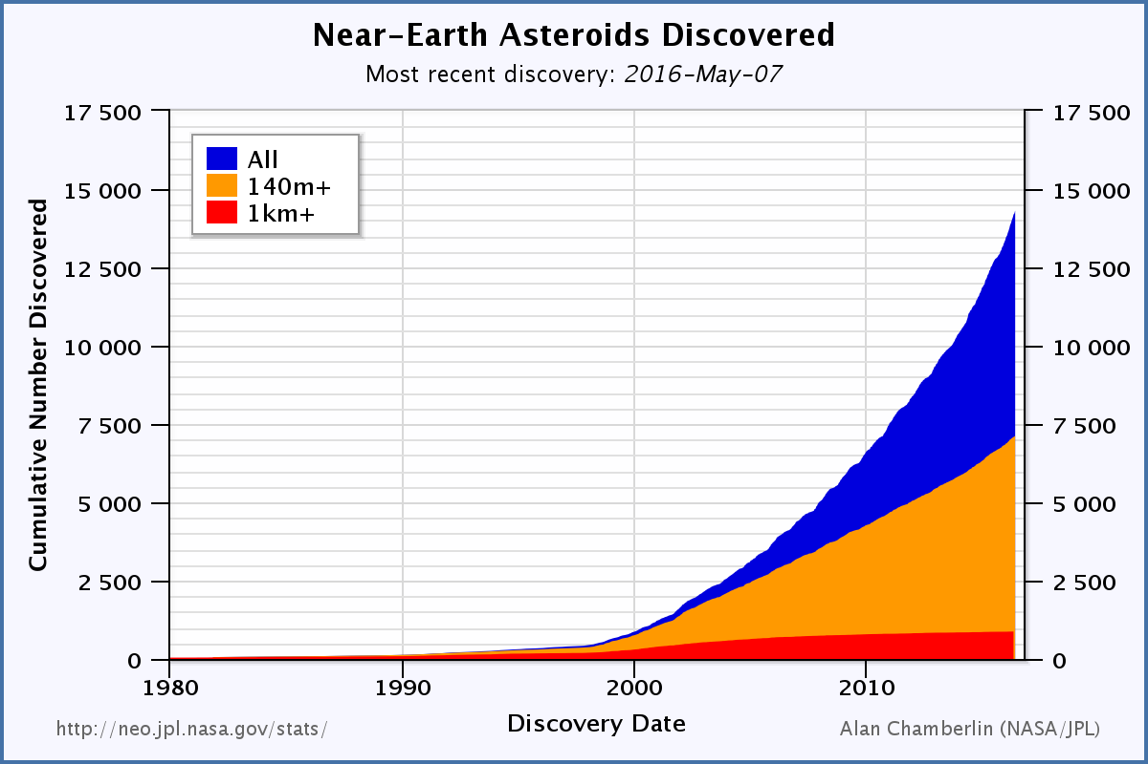
MILLIONS OF MISSING ASTEROIDS!
CONNECTING PARTIAL ASTEROID TRACKLETS
However, sometimes observations cannot be matched into a confirmed asteroid.
There are currently 14 million unmatched observations, which make ~3 million total asteroids.
This number is growing quickly as telescope resolution increases

Slide 4
A HARD PROBLEM…
High asteroid density makes clustering difficult
From Earth, asteroids trajectories are highly non-linear
Missing data (cannot tell asteroid movement/velocity in the z direction)
Sparse observations can be months or years apart
Brute force is impossible with 14m observations

Slide 5
PROPOSED
SOLUTION
HELIOCENTRIC FRAME
SIMPLIFIES CLUSTERING!

Slide 6
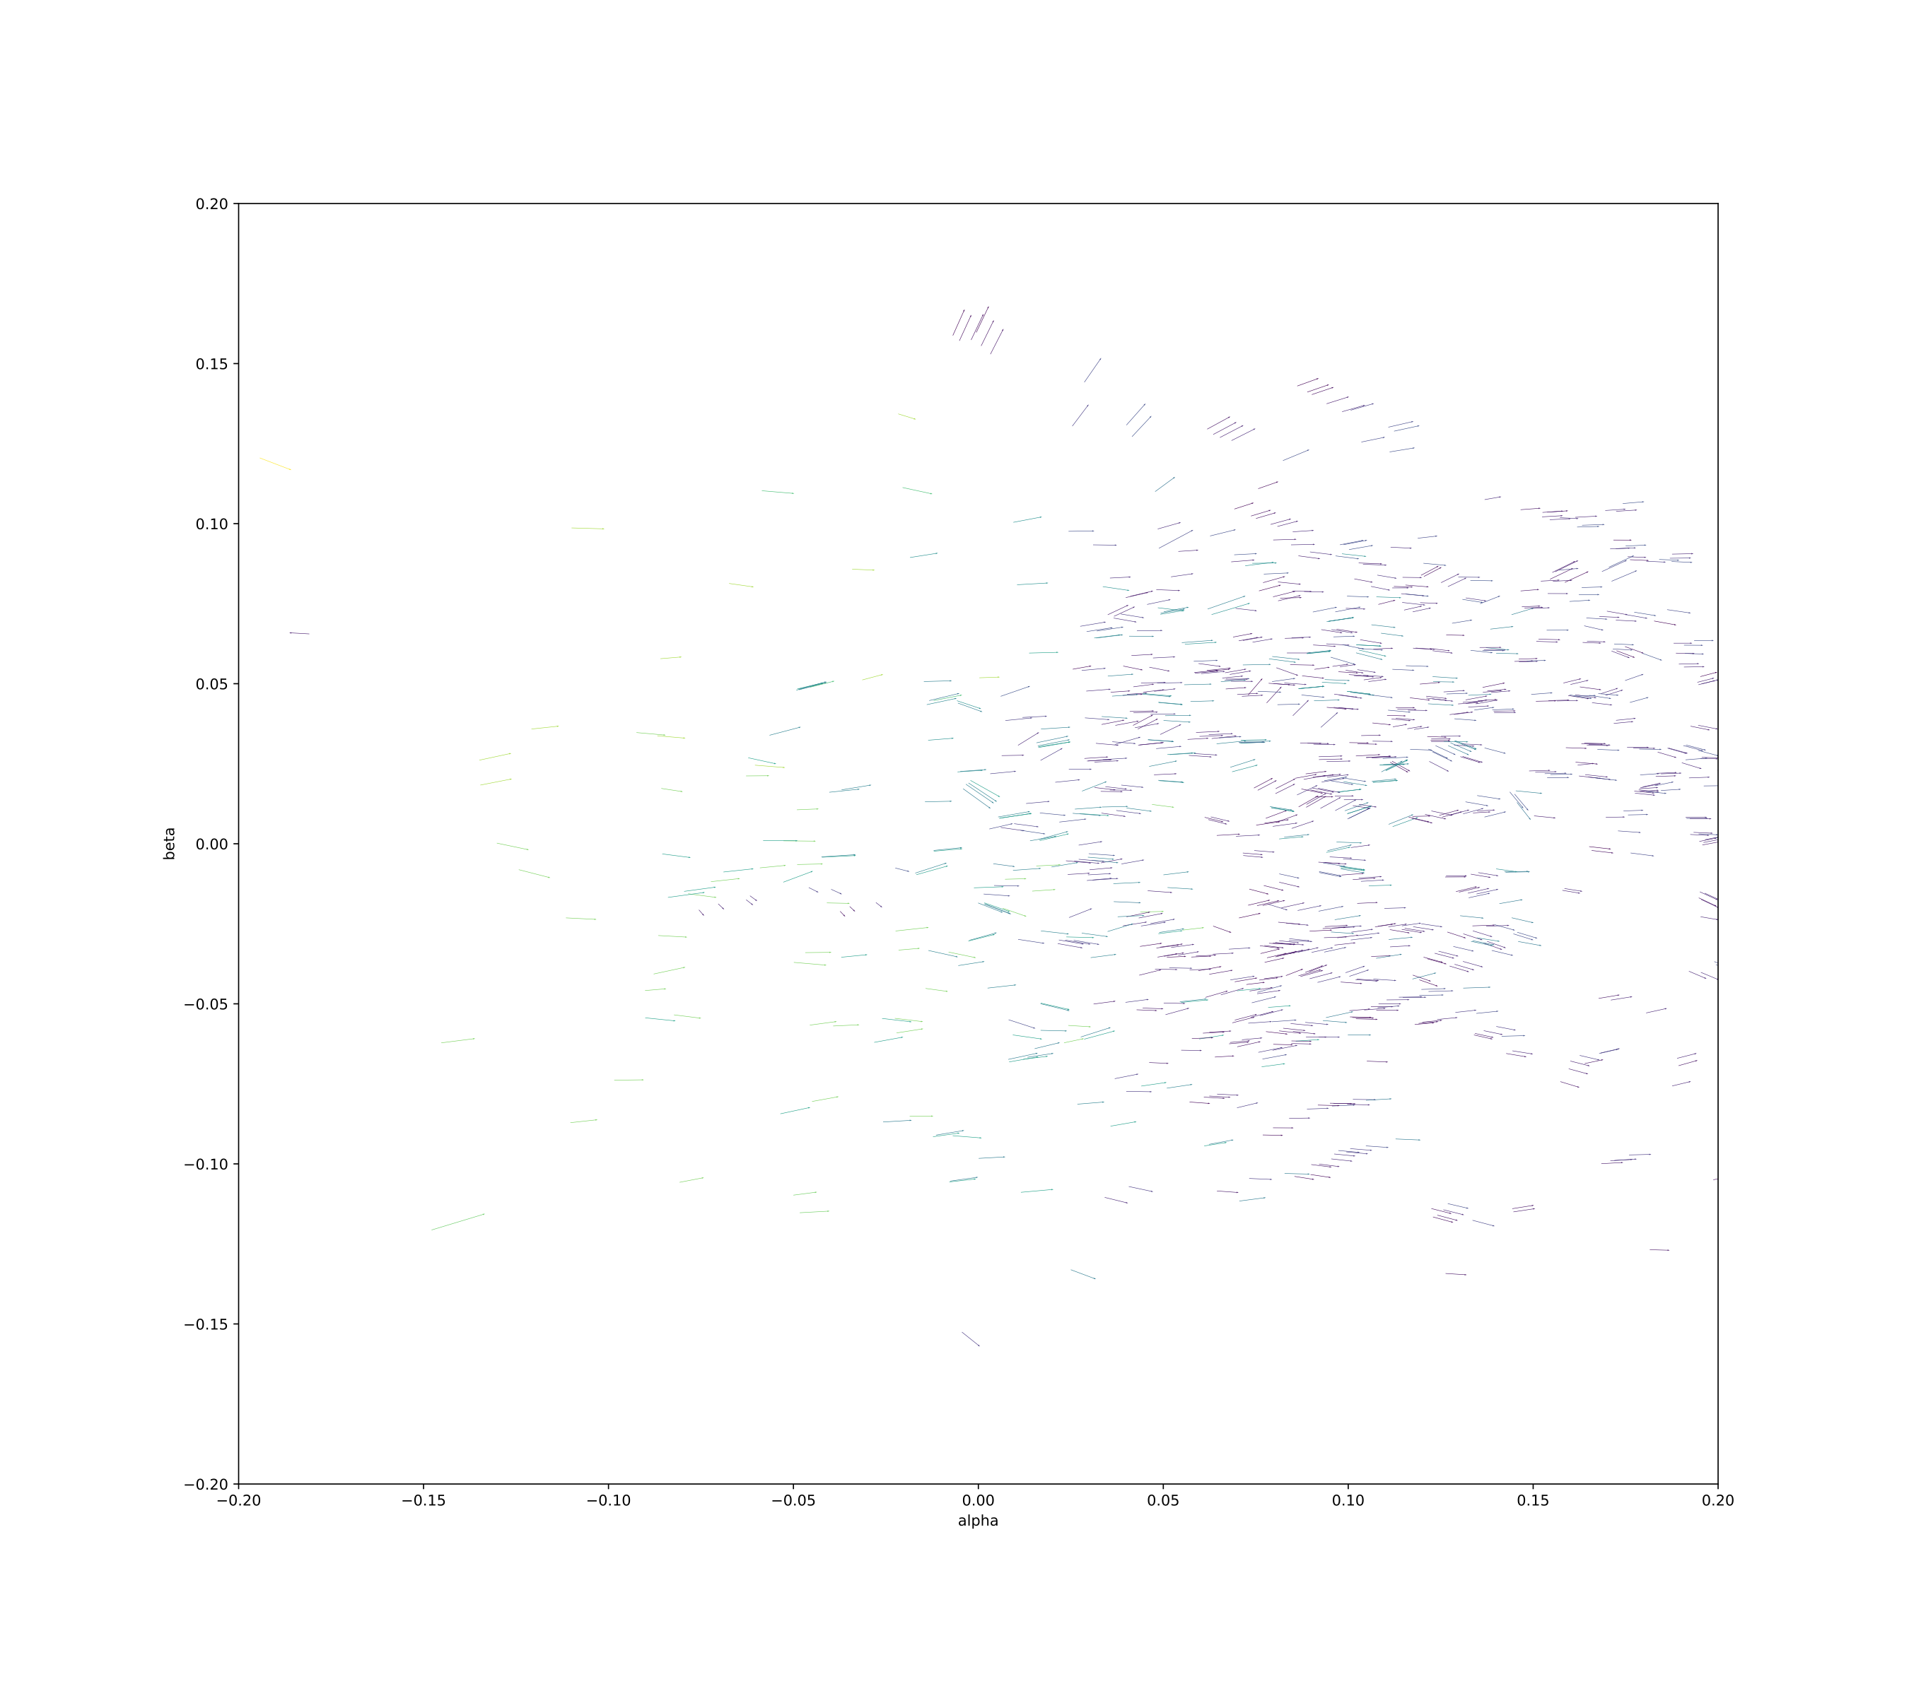
THE VIEW FROM THE SUN

Slide 7
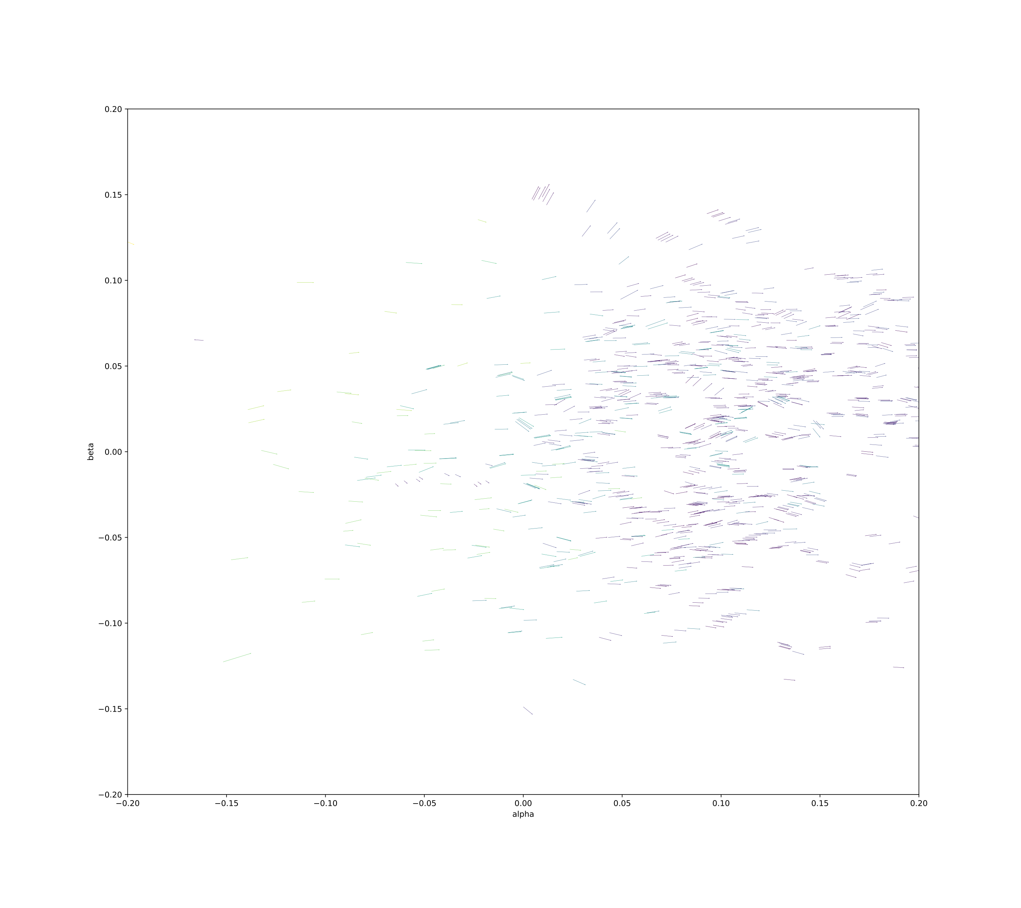
THE VIEW FROM THE SUN

Slide 8
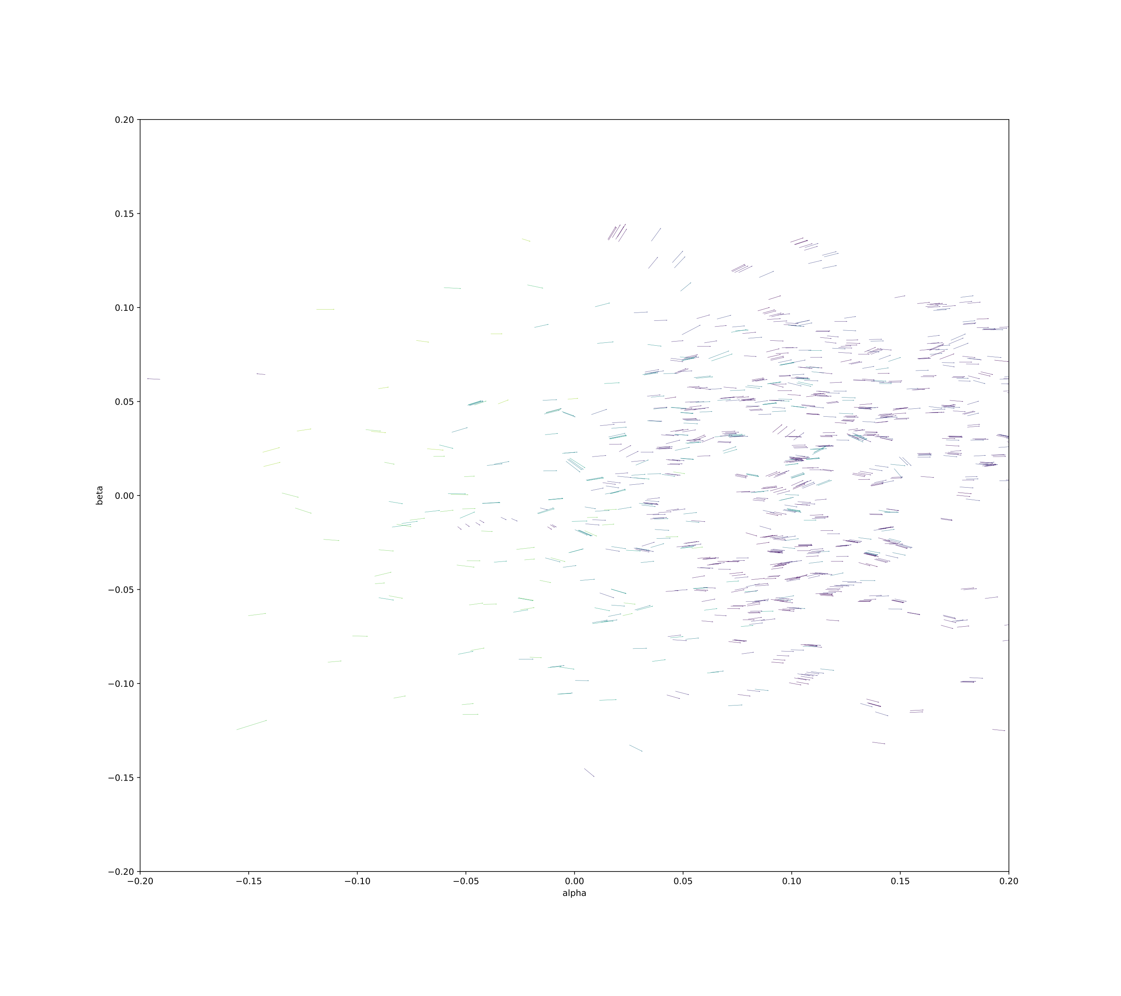
THE VIEW FROM THE SUN

Slide 9
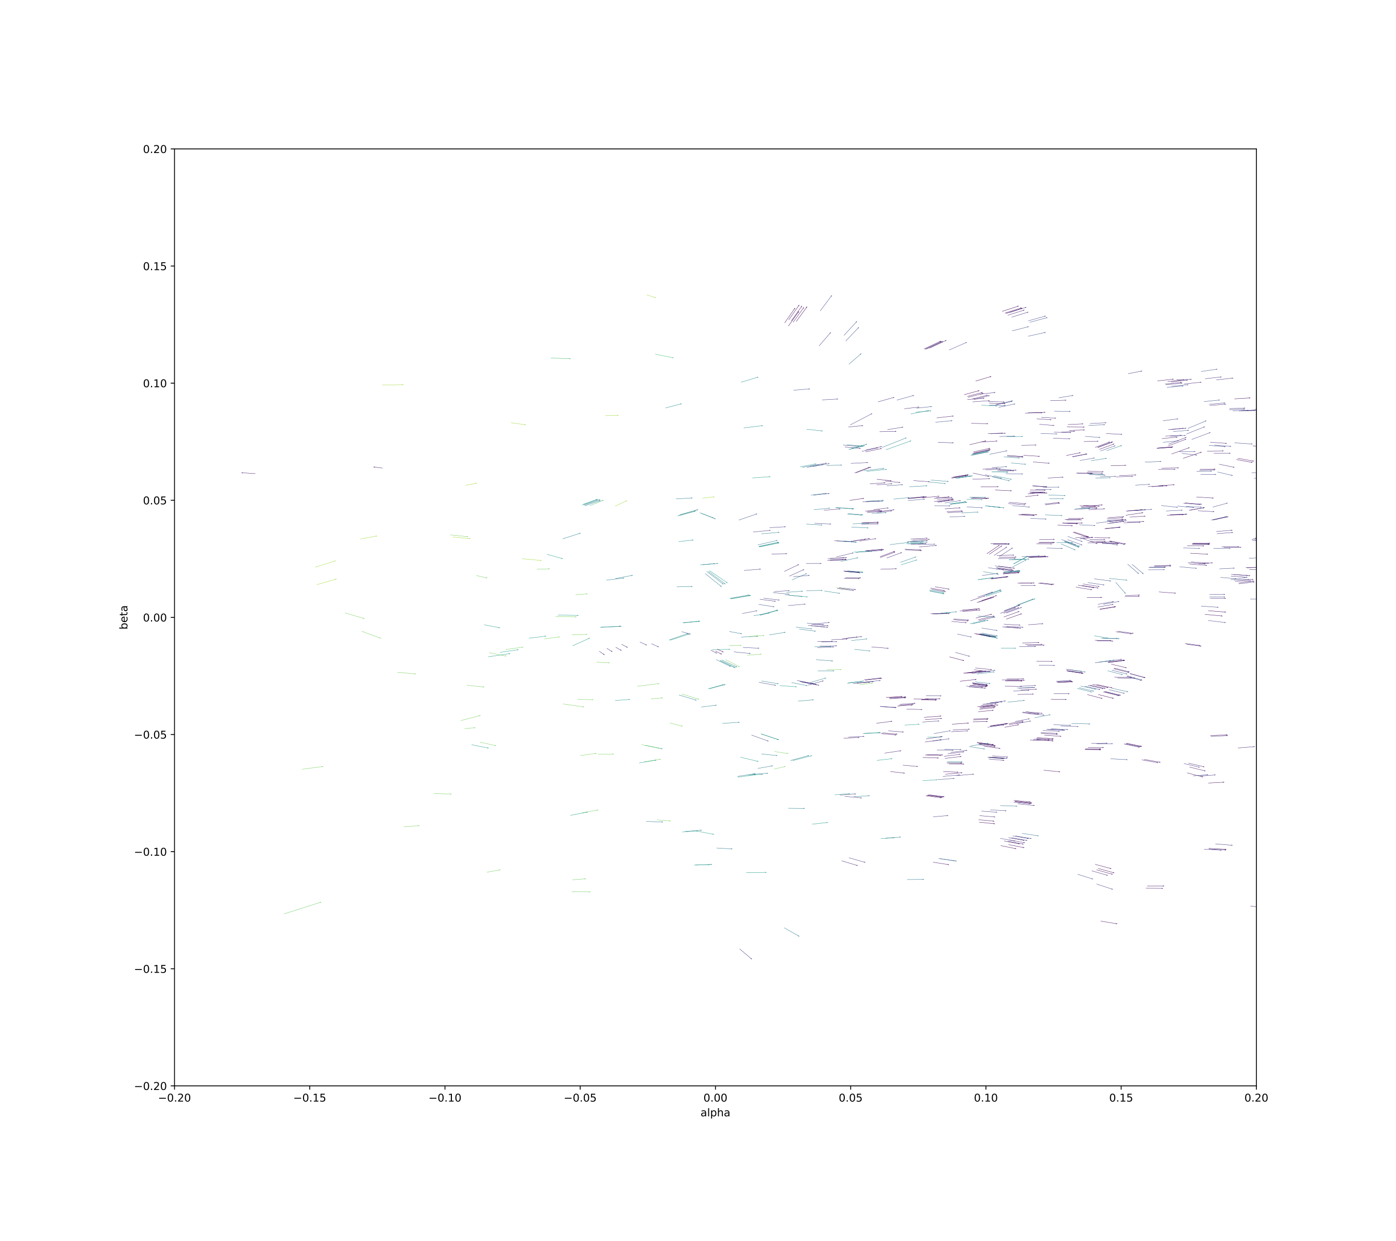
THE VIEW FROM THE SUN

Slide 10
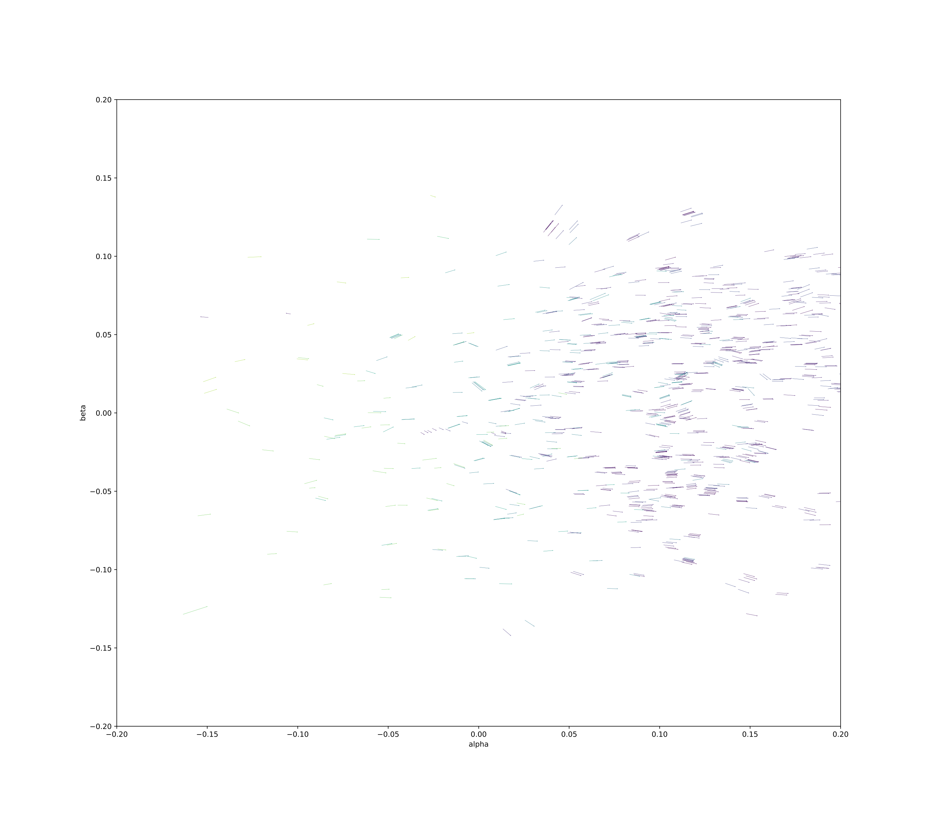
THE VIEW FROM THE SUN

Slide 11
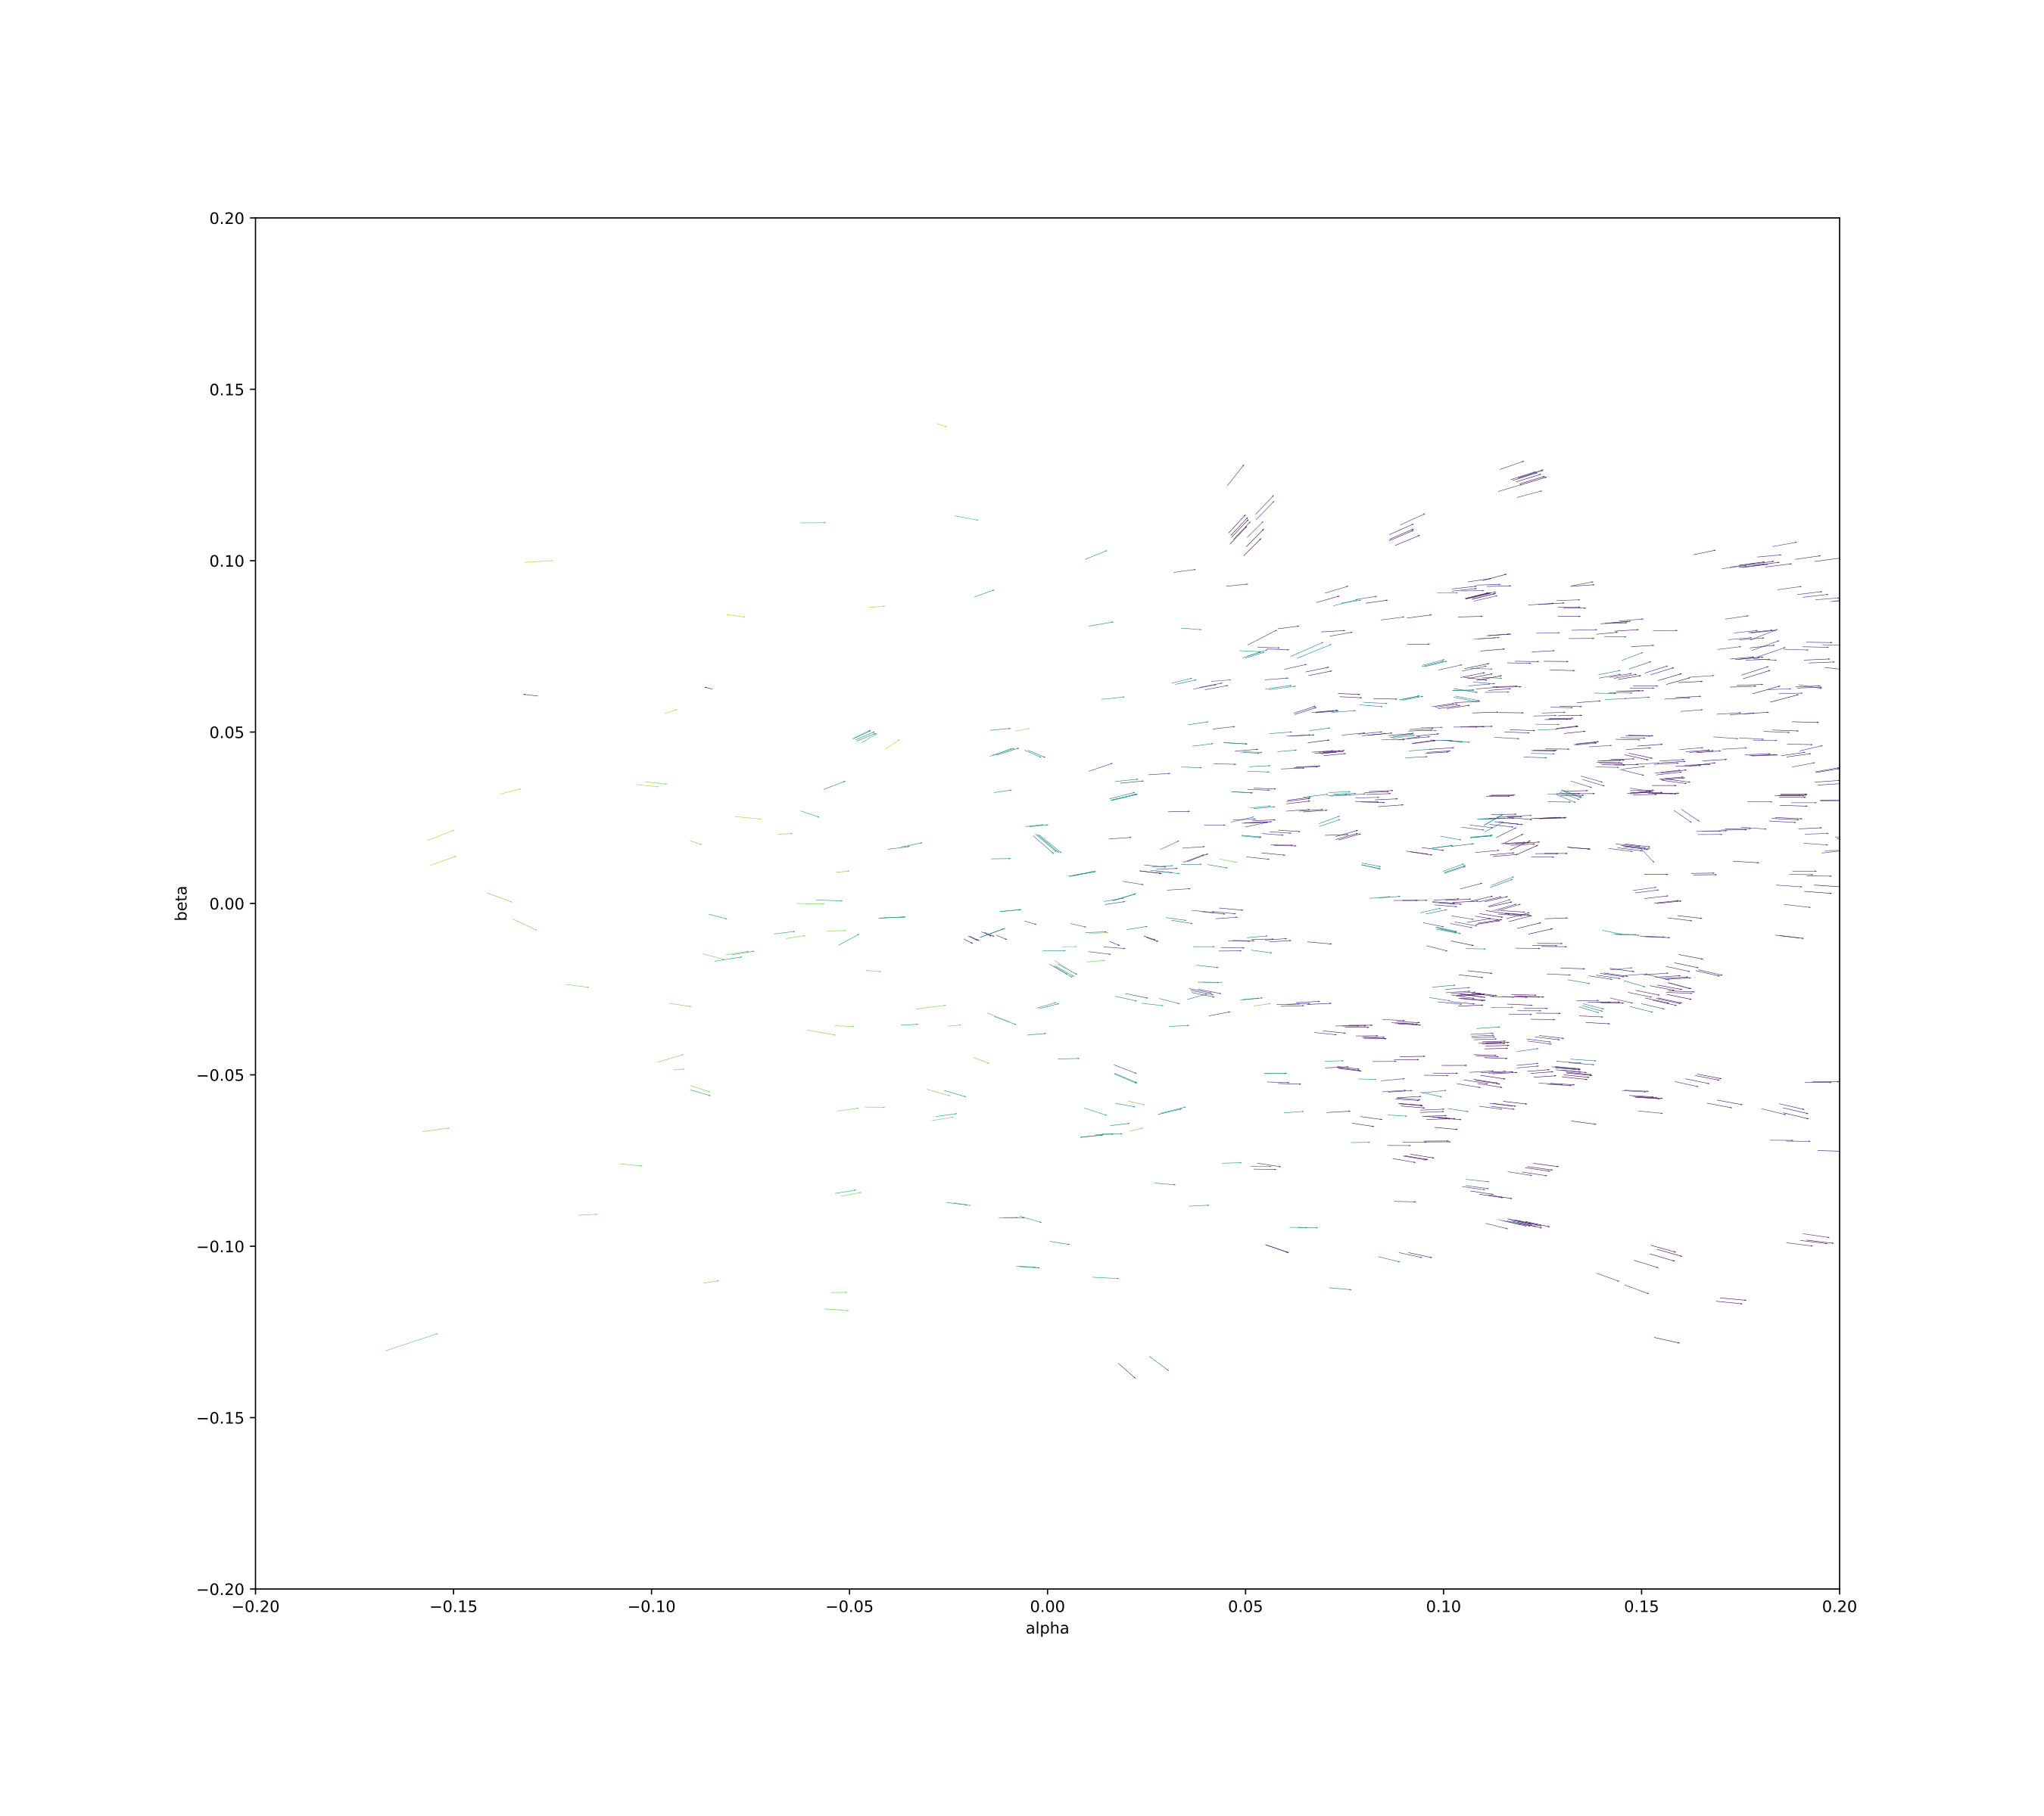
THE VIEW FROM THE SUN

Slide 12
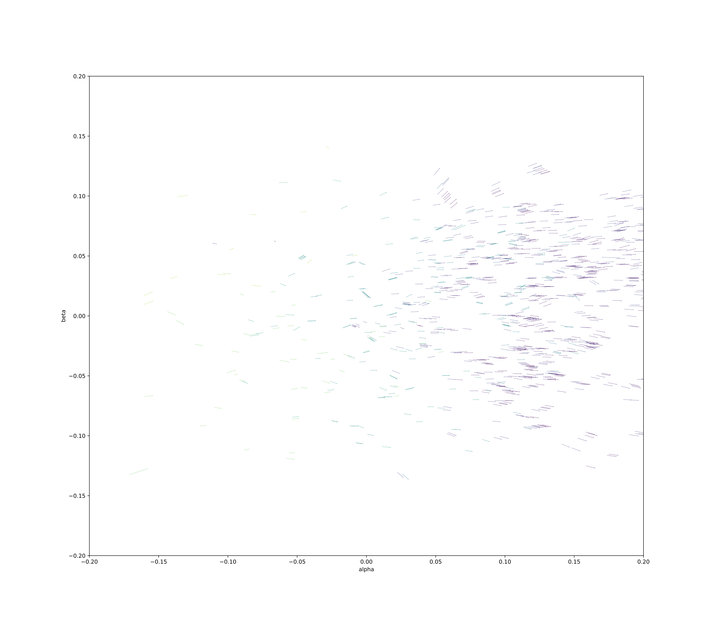
THE VIEW FROM THE SUN

Slide 13
CORE INTUITION
We propose a transformed heliocentric view.
This view lets us compare asteroid tracklets in common time.
Since the heliocentric view allows comparison in common time, it makes clustering methods very applicable.
HELIOCENTRICITY

Slide 14
OUR METHODOLOGY
!!!
Running full sky in a single cluster is computationally intractable [O(n log n)]
1.
DIVIDE SKY INTO !!! PLANES
AND 300 TIME SLICES
2.
ASSERT THE (UNKNOWN)
Z-DISTANCE FROM THE SUN

Slide 15
OUR METHODOLOGY
!!!
1.
DIVIDE SKY INTO !!! PLANES
AND 300 TIME SLICES
4 of our 6 motion parameters are known, and 1 is relatively constant
Model is linear in the parameters
2.
ASSERT THE (UNKNOWN)
Z-DISTANCE FROM THE SUN
ITERATE OVER Z-VELOCITIES, SOLVE OTHER MOTION PARAMS
3.
CLUSTER BASED ON 6 PARAMS: X/Y/Z POSITION, X/Y/Z - VELOCITY
4.

Slide 16
OUR METHODOLOGY
TUNE CLUSTERING HYPERPARAMETERS OVER A KNOWN TRAINING SET (THANKS TO MINOR PLANET CENTER)
TRAIN CLUSTER RADIUS/WEIGHTING
1.
DIVIDE SKY INTO !!! PLANES
AND 300 TIME SLICES
We tune two hyper-parameters:
1) OPTIMAL
CLUSTER RADIUS
2) WEIGHTING OF
VELOCITY VS.
POSITION
2.
ASSERT THE (UNKNOWN)
Z-DISTANCE FROM THE SUN
3.
ITERATE OVER Z-VELOCITIES, SOLVE OTHER X/Y MOTION PARAMS
CLUSTER BASED ON 6 PARAMS: X/Y/Z POSITION, X/Y/Z - VELOCITY
4.

Slide 17
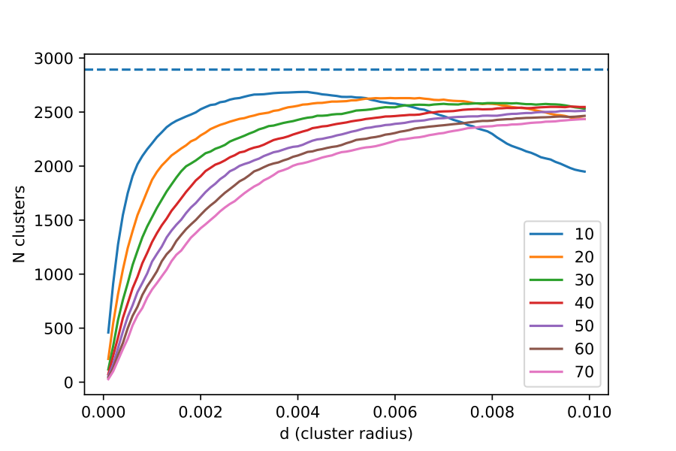
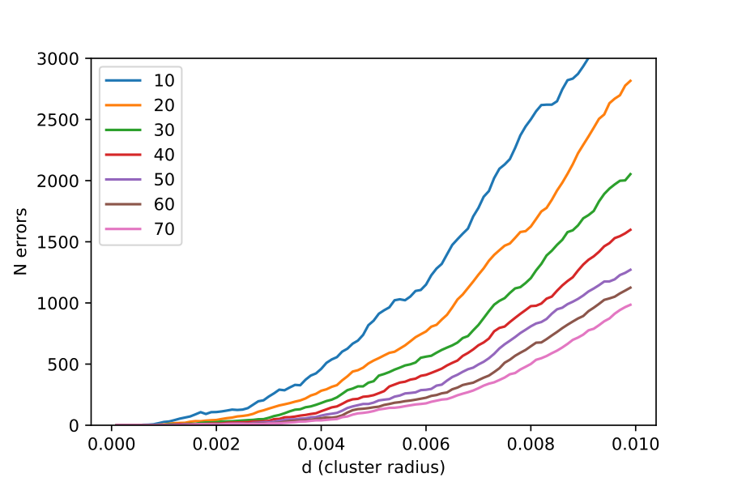
Total clusters detected vs. KD-tree cluster radius (training set)
TUNING PERFORMANCE
OPTIMAL CLUSTER
RADIUS: 0.005-0.010AU
Error rate vs. KD-tree cluster radius (training set)
Selected KD-tree clustering for optimal speed (!!!)
Also had good results with agglomerative clustering

Slide 18
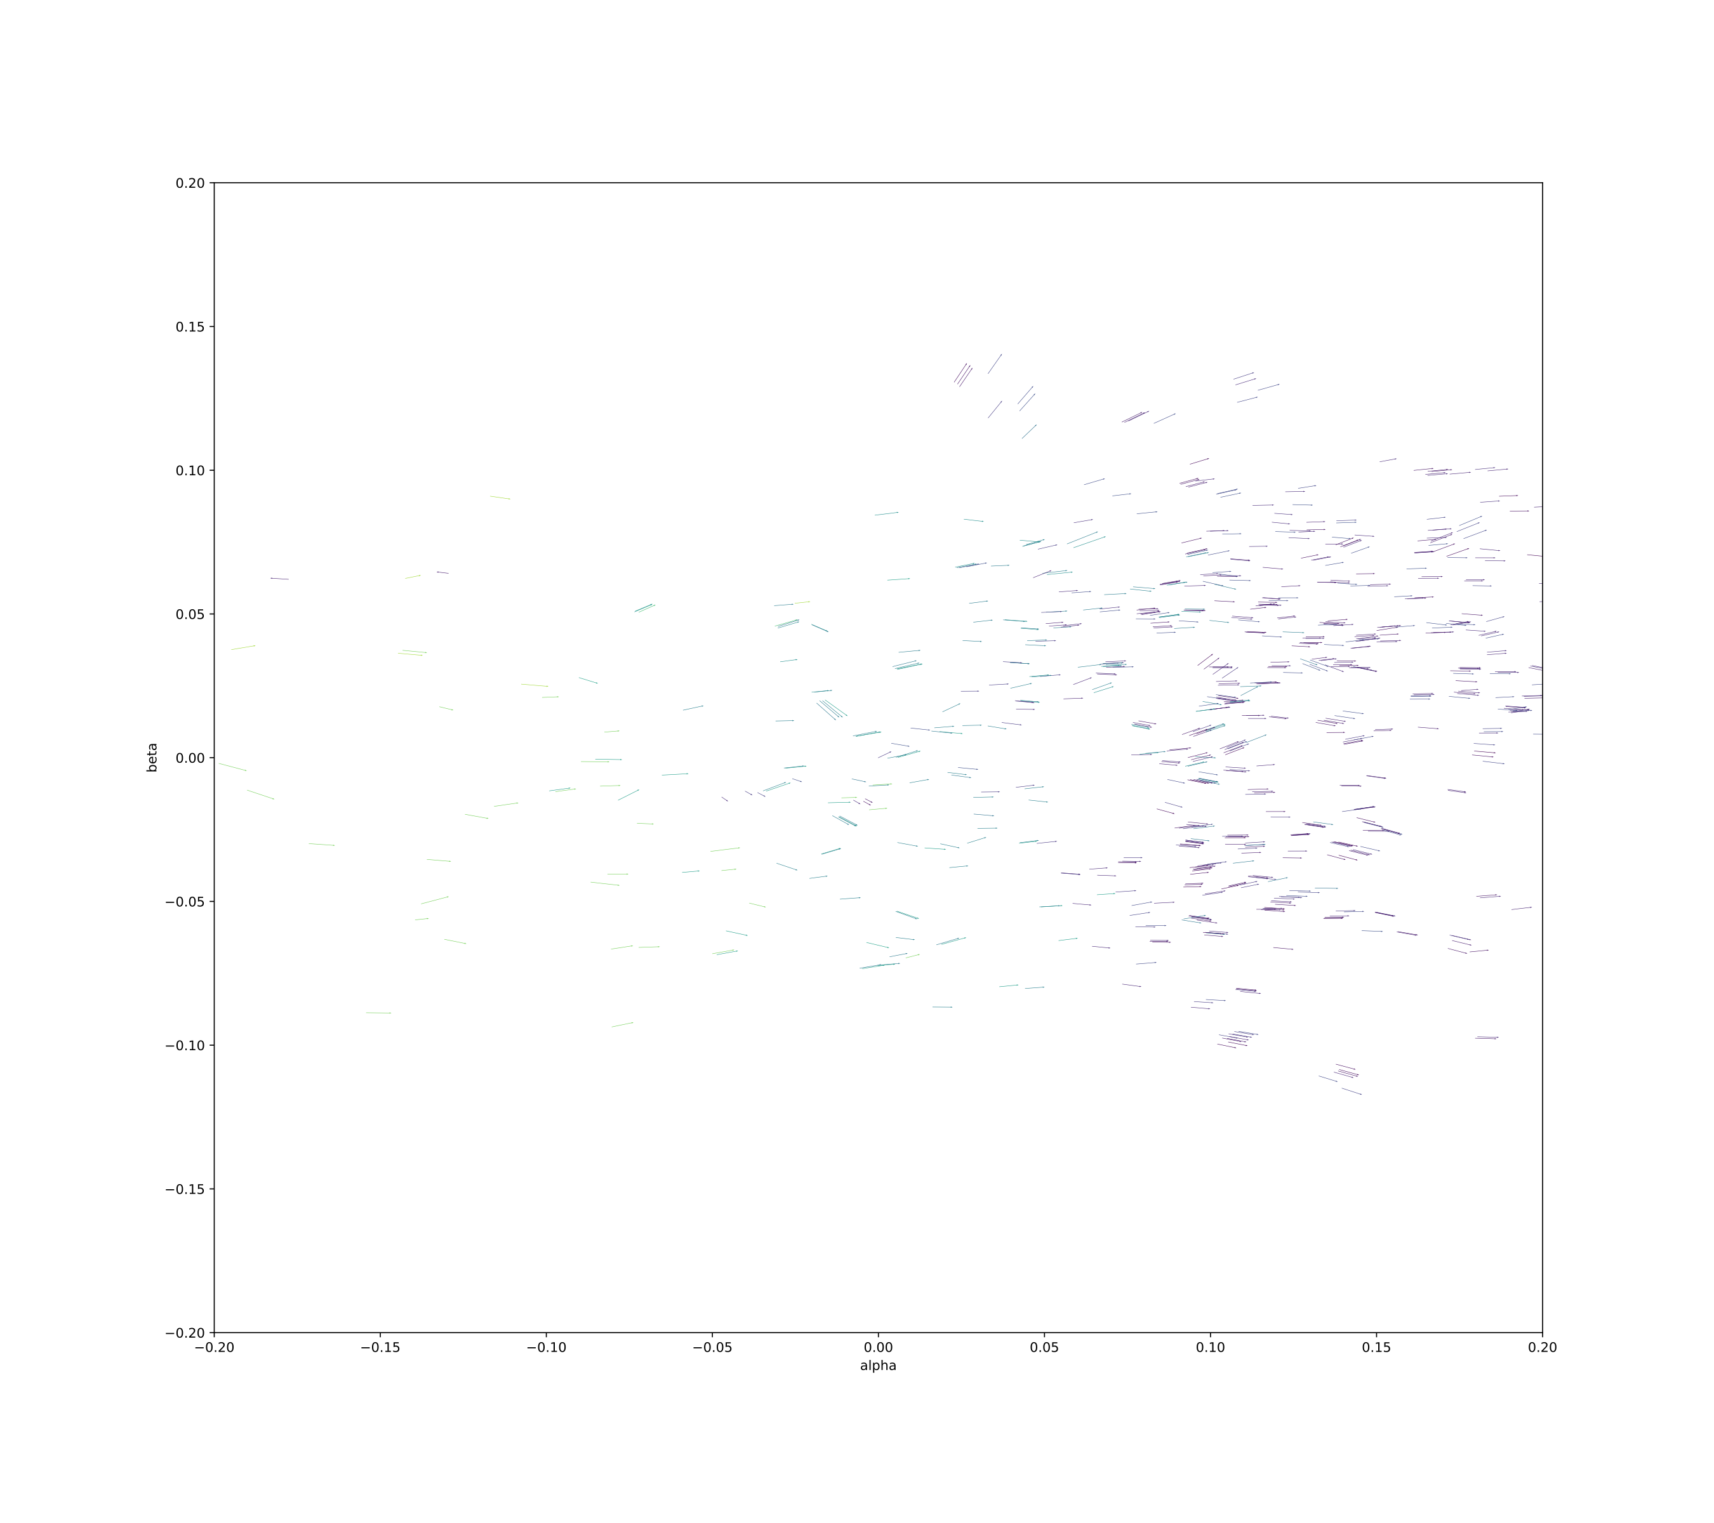
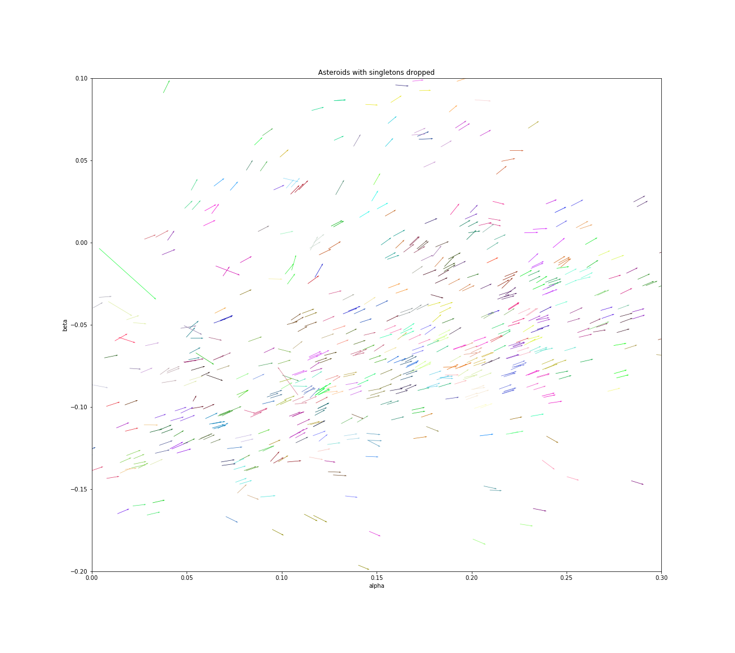
RESULTS
SUCCESSFULLY IDENTIFIES 90% OF ASTEROIDS

Slide 19

CONCLUSIONS, LIMITATIONS, NEXT STEPS
CONNECTING PARTIAL ASTEROID TRACKLETS
- We were able to find matching tracklets using the heliocentric transform and KD-Trees
- We were also able to do so in just O(n log n) time, a scalable solution!!
- Limitations: possible improvement in a more accurate clustering method
- Next Steps: Run the algorithm over the entire 14m ITF!

Slide 21
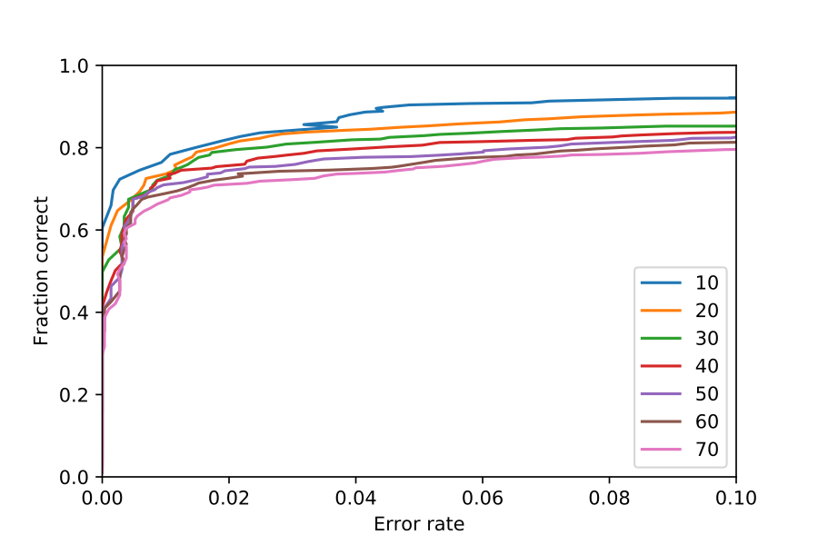

Slide 22
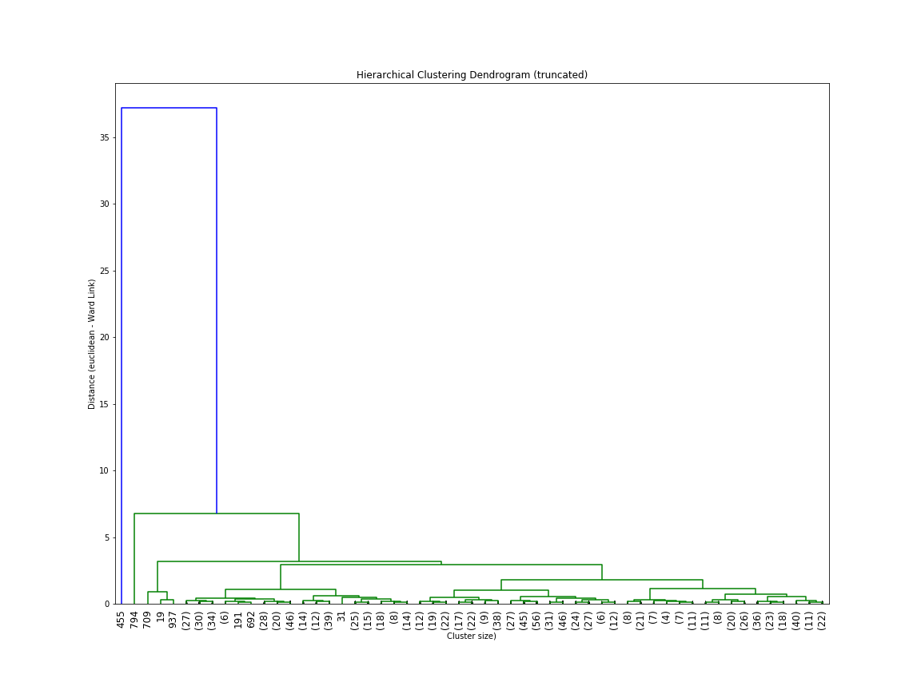

Slide 23
The first insight which becomes apparent from the study is that Singularity University is doing a great (and increasingly great) job!
The 2014 class created a much higher number of new entrepreneurs than the 2013 class (almost double).
The 2014 class also increased its number of technically-skilled students (which we will see later is important to business creation).
2013 vs 2014 GSP
GREAT PROGRESS
BEFORE GSP
BEFORE GSP
AFTER GSP
AFTER GSP
SINGULARITY CREATED ALMOST TWICE AS MANY ENTREPRENEURS IN 2014…

Slide 24
Secondly, the overall number of students who chose to launch their projects after the GSP has increased by one third in the past year.
As a key metric of this study, and (as I understand) a top priority for the University, this is a huge win.
The question, then, is what is driving this improvement? And how can SU continue to improve?
We’ll examine these questions in detail over the next several slides.
2013 vs 2014 GSP
GREAT PROGRESS
Proportion of students with GSP project businesses post-graduation:
18%
2013 GSP
2014 GSP
24%
…AND NOW, MORE STUDENTS ARE LAUNCHING THEIR PROJECTS AFTER THE GSP.

Slide 25
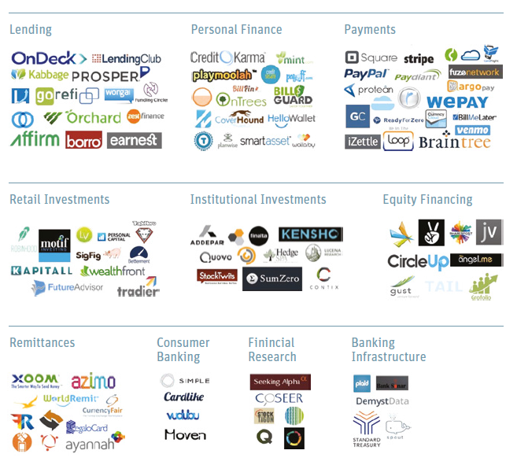

A DIVERSE SECTOR
FINTECH AND FINANCIAL SERVICES
A unique investing skill-set
In my experience investing in Fintech, I’ve learned that the sector needs both a unique skill-set and approach
Fintech is unique to other growth sectors in several ways:
Regulation – Understanding regulatory environment (and more importantly, how regulation may change) is highly important for managing downside risk
Incumbents – Companies within the sector are often displacing large, entrenched incumbents. Focus and speed are key
Differentiation – Capital is a commodity. A clear, sustainable competitive advantage is especially important here. And the advantage must be structural to the business model, rather than dependent on team or a short-term relationship
The following pages present three sector opportunities which satisfy these requirements
source: Silicon Valley Bank, CB Insights

Slide 26

INSIGHT #1
TECHNICAL STUDENTS
82% OF ALL TEAMS THAT LAUNCHED THEIR PROJECT POST-GSP HAD A TECHNICAL TEAM-MATE.
82%
The GSP Needs Techies!
Out of every factor I examined, the single-most important factor for post-GSP success is presence of technical team members.
Each team with a technical team member in 2013 or 2014 was 44% more likely to continue their project post-GSP (versus non-technical teams).
Multiple technical team members on a team did not add additional success.
Back calculation shows the ideal ratio of technical members in the class should be between 25% and 30%.
TEAMS WITH AT LEAST ONE TECHNICAL MEMBER WERE 44% MORE LIKELY TO LAUNCH THEIR PRODUCT.

Slide 27

SINGULARITY GSP
AND POST-GSP SUCCESS
A High-Potential Organization
Singularity University is a leading institution at the forefront of innovation, with some of the highest potential for creating lasting change.
So why, then, don’t more Singularity University class projects become real-world businesses?
High-Potential Projects
I’ve set out to understand the reasons why this is, by performing a deep-dive data analysis on previous classes.
In this document, I’ll:
share these key insights, and
highlight what actions could be taken to help more SU GSP projects become global businesses.
At a glance:
(ALL 2013 VALUES) | VODAFONE GMBH | VODAFONE GROUP PLC
Domicile | Germany | UK
Headquarters | Dusseldorf | Newbury, Berkshire
Employees | >11,000 | >91,000
Customers | 32 million | 404 million
Turnover | €9.5 billion | €44.4 billion
EBITDA | €3.4 billion | €13.3 billion
EBITDA Margin | 35% | 30%
Ownership | 100% subsidiary of Vodafone Group PLC | FTSE 100 listed, $180bn market cap (Oct-2013)

